Slide 1
Keyword and Named Entity Recognition on Air Traffic Control Text
Final Year Project SCSE19-0009
Andy Ng Chin Kuan
U1621910C
Under Prof Chng Eng Siong

Slide 2
Outline
Background information
Objectives and Scope
Literature Review
Air Traffic Control Text
System Implementation and Design
Demo
Conclusion and future work

Slide 3
Background information
Air travel has become convenient
Primary communication through radio between Air Traffic Controllers and pilots
Communication failures had caused deaths of more than 2000 people in plane crashes since the mid-1970s
Effective communication is significant for aviation safety

Slide 4
Objectives and Scope
Apply existing natural language processing techniques to detect and annotate named entitles in Air Traffic control text
Train a named entity recognition model to identify named entities
Implementation of a speech to text recognizer on demo website

Slide 5
Literature Review

Slide 6
Named Entity Recognition
Refers to identifying and classifying keywords or named entities located in unstructured text into pre-defined categories
Sub-task of Information Extraction, one of the most thoroughly researched in NLP
For example, human resource departments, news providers

Slide 7
Word embeddings
Numerical representation of words usually in vector shape
Categorize words with similar meaning into same representation
Each word mapped to one vector

Slide 8
ELMo
Refers to Embeddings to Language Model
Deep contextualized word representation which models characteristics of word use
Identify polysemy, words with multiple meanings
One example is ‘John wants to borrow a book’ and ‘John wants to book a flight’

Slide 9
Current Named Entity Recognition Systems
Classical approaches are done before the adoption of neural networks
More recently, the Bi-LSTM-CNN-CRF model is used for training of NER systems
For instance, Allennlp

Slide 10
Air Traffic Control (ATC) text

Slide 11
ICAO alphabets and numbers
ICAO refers to International Civil Aviation Organization
Uses radiotelephone spelling to represent letters of an alphabet in oral communication
For instance, M and N are similar in pronunciation which may lead to communication errors

Slide 12
Callsign
A unique identifier for an airplane
Normally defined as an airline designator followed by a flight number
For example, Singapore four three two

Slide 13
Runway
Defined as a strip of land where an aircraft takes off and land
Named after compass bearings of Earth’s magnetic field
Examples include 28L, 28C, 28R

Slide 14
Taxi
Aircraft uses its own power to move on the ground
Occurs when aircraft has just landed or preparing for takeoff
Example: Singapore One Two Three Taxi Via Runway Three Five Right

Slide 15
Frequency
Each airport will have different frequencies that pilots and ATC will communicate with
All ATC communication frequencies between 118.0MHz and 137.0MHz
For example, to cross runway, pilot must switch from ground frequency to the tower frequency

Slide 16
System implementation and Design

Slide 17
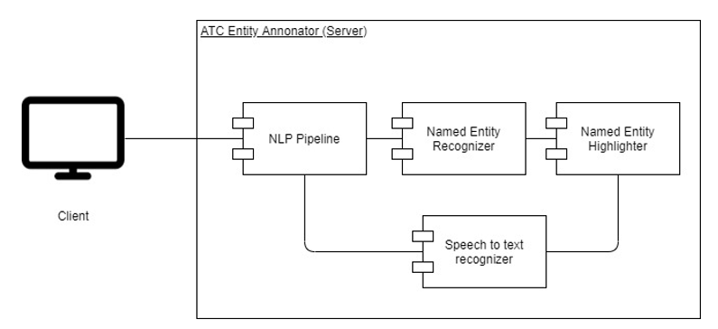
System Architecture

Slide 18

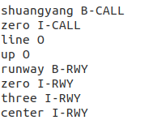
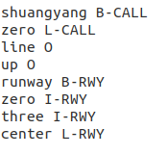
Named Entity Recognizer
BIO tagging of ATC text
BILOU tagging of ATC text

Slide 19
Generation of dataset
Find actual Air Traffic transcripts and annotate them manually or through a script
Generate Air Traffic transcripts through a context free grammar

Slide 20
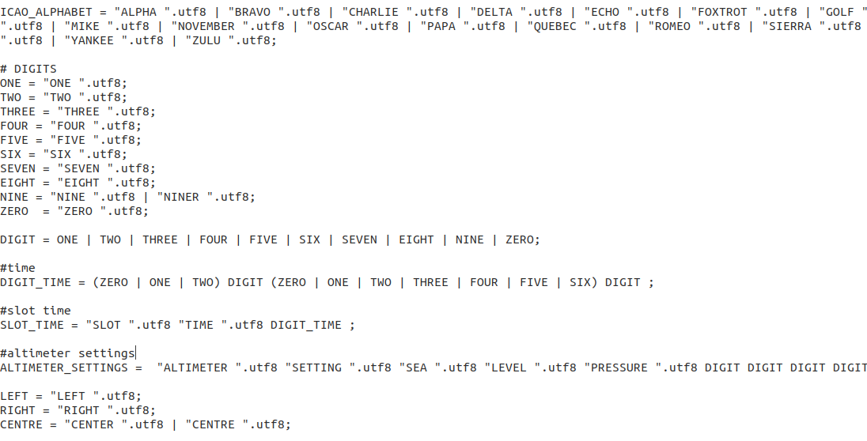
Generation of dataset

Slide 21
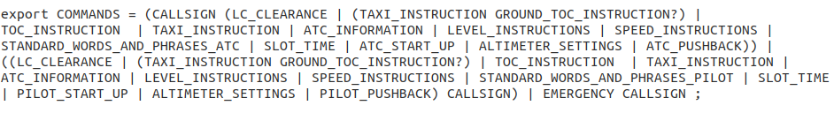
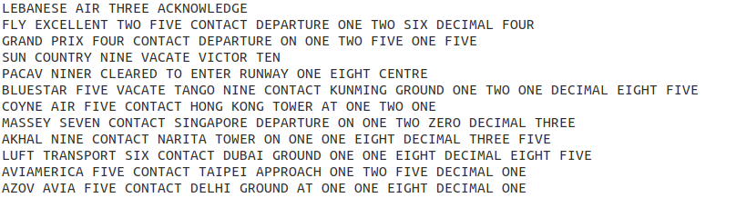
Generation of dataset

Slide 22
Model trained and Evaluation
Model that was previously trained can only detect ATC communicating to pilots
Limited amount of airline designators in grammar file leads to overfitting
A more generalized model is trained, 800,000 for training, 100,000 will be used for validation

Slide 23
Model trained and Evaluation
 | Precision | Recall | F1 score | Loss
Training | 0.99677 | 0.99625 | 0.99651 | 14.427
Validation | 1.0 | 1.0 | 0.99999 | -0.00011

Slide 24
Speech to text recognizer
Integrated into the system to simulate speeches made by the ATC
Performs speech recognition for speech-to-text
Data streamed to the system is used by a microphone input to the website

Slide 25
Demo

Slide 26
Conclusion
Improve number of name entities and keywords of ATC conversations detected
Model will be trained using Google Colab
Implementation of speech to text function

Slide 27
Future Work
Other ground vehicles are present in the airport runways. For example, baggage collectors
Improve annotation time for ATC text
Listen to live ATC speeches spoken by air traffic controllers themselves

Slide 28
Thank you

